Slide 1



ADVENTURE
WORKS CYCLES

Slide 2

Contents
INTRODUCTIONS
1 TEAM
2 COMPANY OVERVIEW
3 GOALS
ANALYSIS AND REPORTS
4 KPI’S
5 EXCEL
6 TABLEAU
7 POWER-BI
8 MYSQL
HIGHLIGHTS
9 KEY LEARNING
10 PROJECT SUMMARY

Slide 3
TEAM
JAYANTHY PRAHASHIT
ALSHA KUMARI
JAHNAVI ADAPA
PRERANA ALANDE
SOMYA BEHERA
SUMIT NAYAK
ROHIT CHAVAN

Slide 4
Company Overview
Introduction
#1
#2
Multinational cycle manufacturing company.
Manufactures and sells metal and composite bicycles to North American, European and Asian commercial markets
#3
#4
#5
The main plant is in Bothell, Washington with 290 employees, several regional sales teams are located throughout their market base.
In 2000s, Adventure Works Cycles bought a small manufacturing plant in Mexico. Which manufactures several critical subcomponents for the product line.
Adventure Works plans to target top customers, expand online, and reduce production costs.

Slide 5



Goals
Leverage data-driven insights to optimize sales, customer behavior, and profitability.
Analyze sales patterns to identify growth opportunities.
Understand customer preferences for better decision-making.
Deliver actionable insights to guide strategic business decisions.

Slide 6

KPI’S AND INSIGHTS

Slide 7





Sales
Profit
Customers
Cost
Income
Quantity
Average Order Value
Average Orders per Day
Average Shipping Time
Average Shipping Cost
Profit Margin

Slide 8
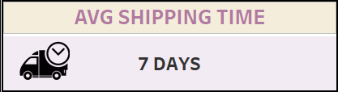
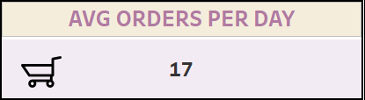
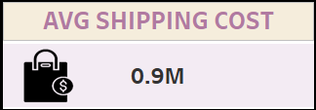
Sales and Profitability:
Total Sales and Profit KPIs will help Adventure Works understand the direct impact of their market expansion and sales strategies. Analyzing profit alongside total sales helps ensure that growth is not just top-line but also bottom-line growth.
Production and Cost Efficiency:
KPIs like Total Production Cost and Profit Margin directly measure whether the company is achieving its goal of reducing production costs. A reduction in production costs while maintaining or increasing profit margins indicates successful cost management.
Customer Satisfaction and Logistics:
Average Shipping Time and Average Shipping Cost provide insights into the logistics operations. Improving these metrics will enhance the customer experience, especially for online customers, and may lead to repeat purchases. Faster and cheaper shipping can be a competitive advantage in the market.

Slide 9
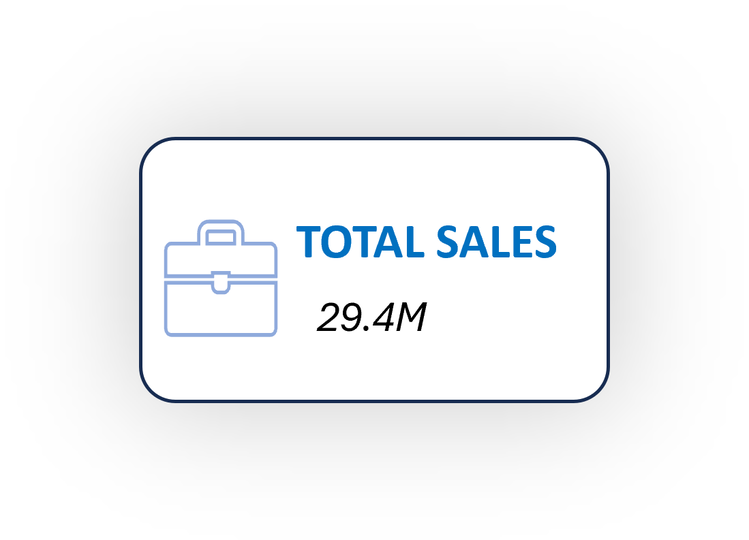
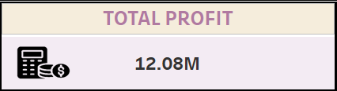
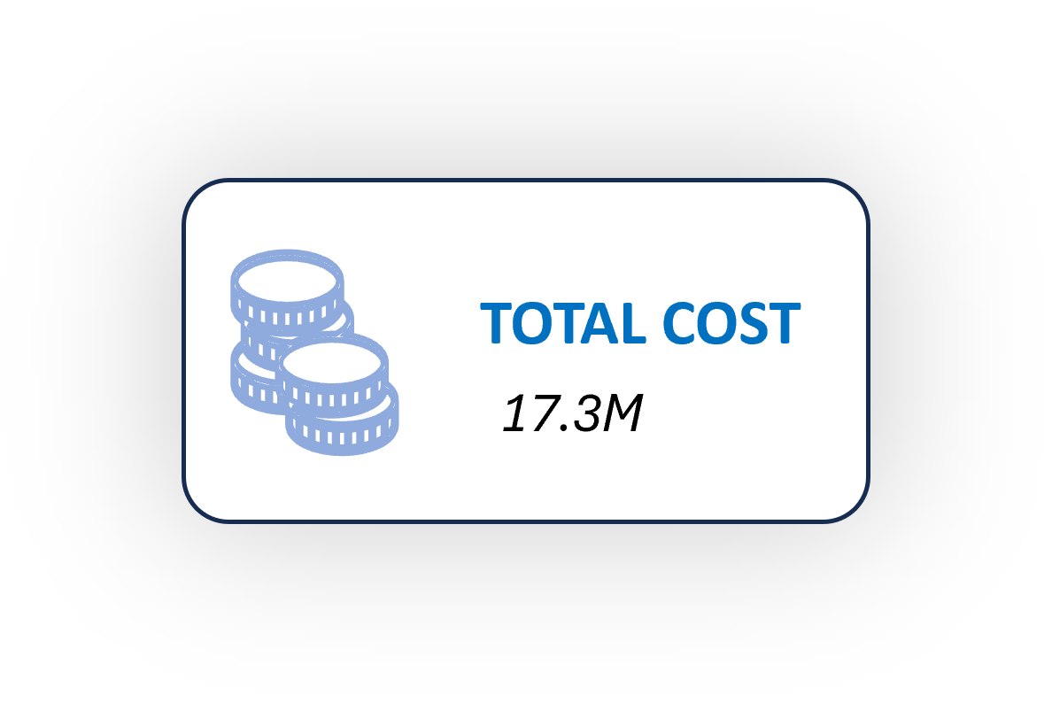
Sales Growth and Market Reach:
KPIs like Average Orders per Day and Total Number of Customers help evaluate the success of the market expansion efforts. A higher number of daily orders and a growing customer base reflect the positive impact of the e-commerce strategy and targeting the best customers.
Track Sales Performance:
KPIs like Total Number of Orders and Sales Growth provide clear insights into the success of the market expansion and customer targeting strategies. More orders and consistent sales growth show that the company’s efforts are driving demand
By regularly tracking and analyzing these KPIs, Adventure Works Cycles can optimize their production, shipping, and sales strategies to ensure they are meeting their business goals, reducing costs, and enhancing the customer experience. This will lead to more informed decisions and a clearer path toward broader market share and increased profitability.

Slide 10

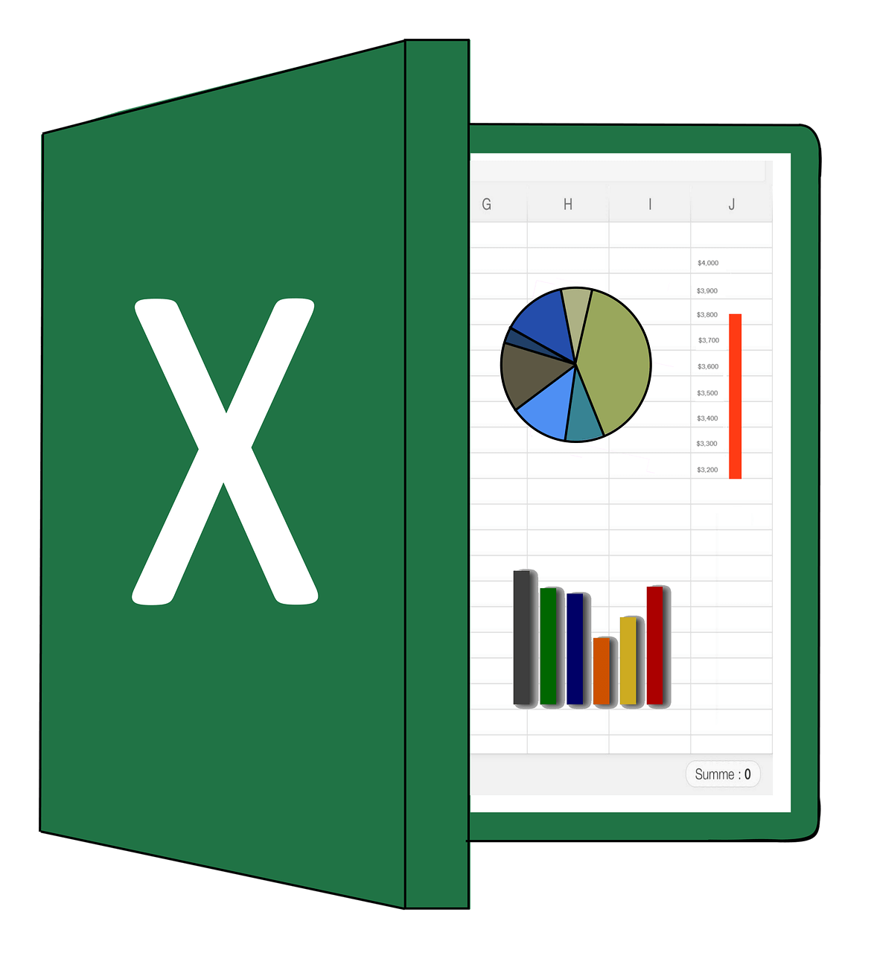

EXCEL DASHBOARDS

Slide 11
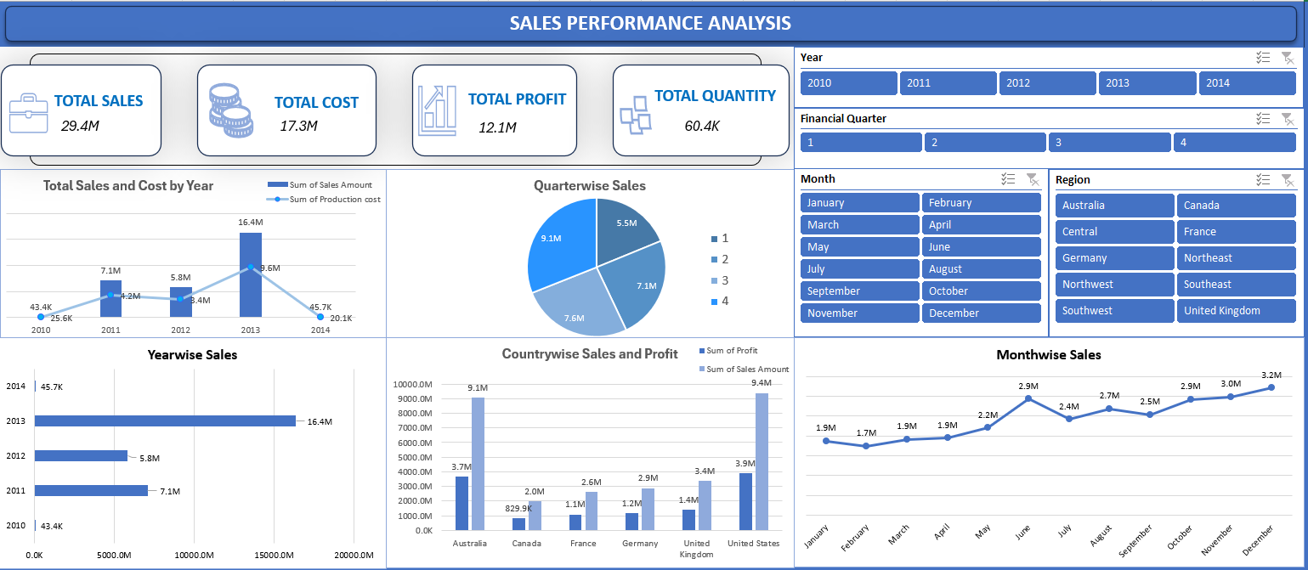
DASHBOARD 1

Slide 12
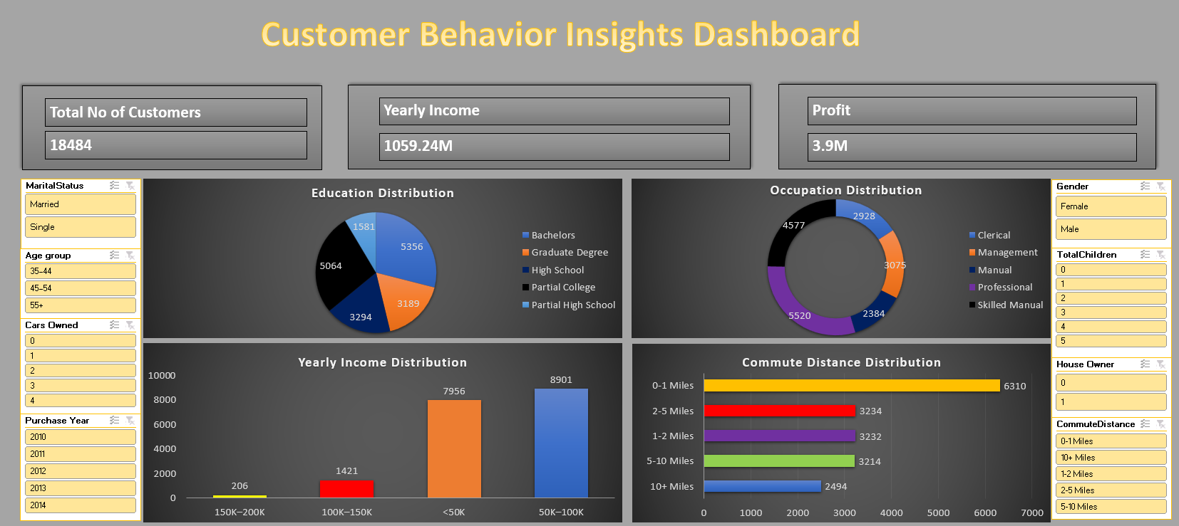
DASHBOARD 2

Slide 13
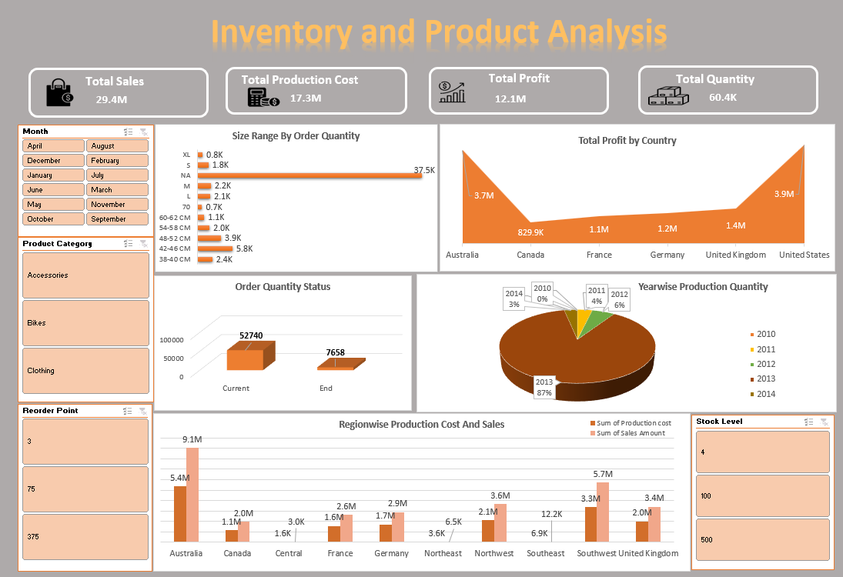
DASHBOARD 3

Slide 14


TABLEAU DASHBOARDS

Slide 15
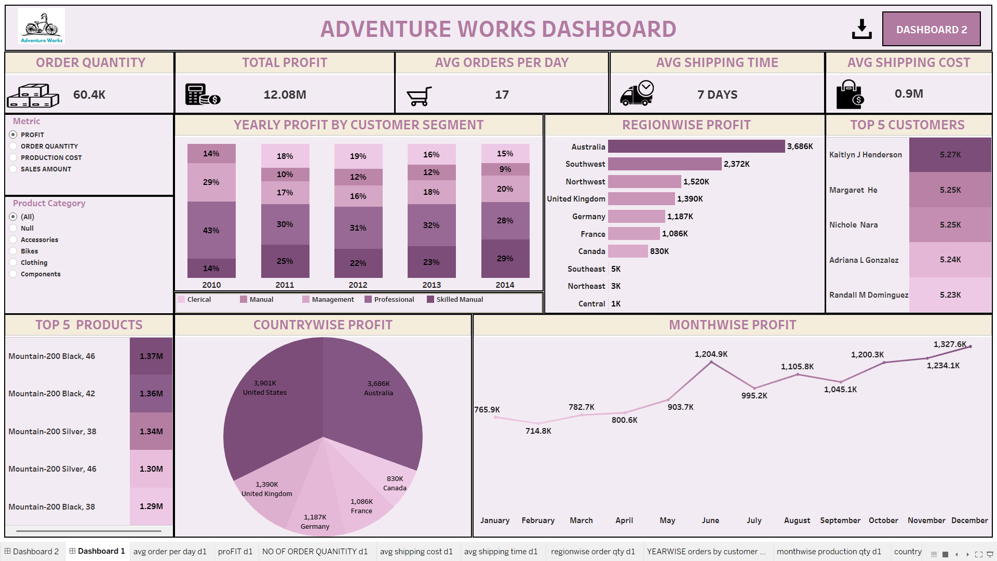
DASHBOARD 1

Slide 16
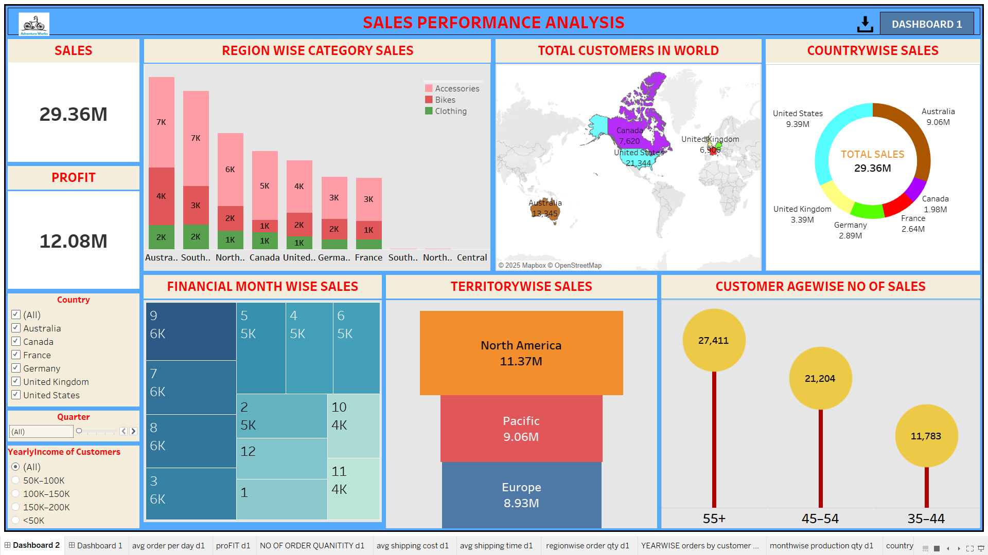
DASHBOARD 2

Slide 17


POWER-BI DASHBOARDS

Slide 18
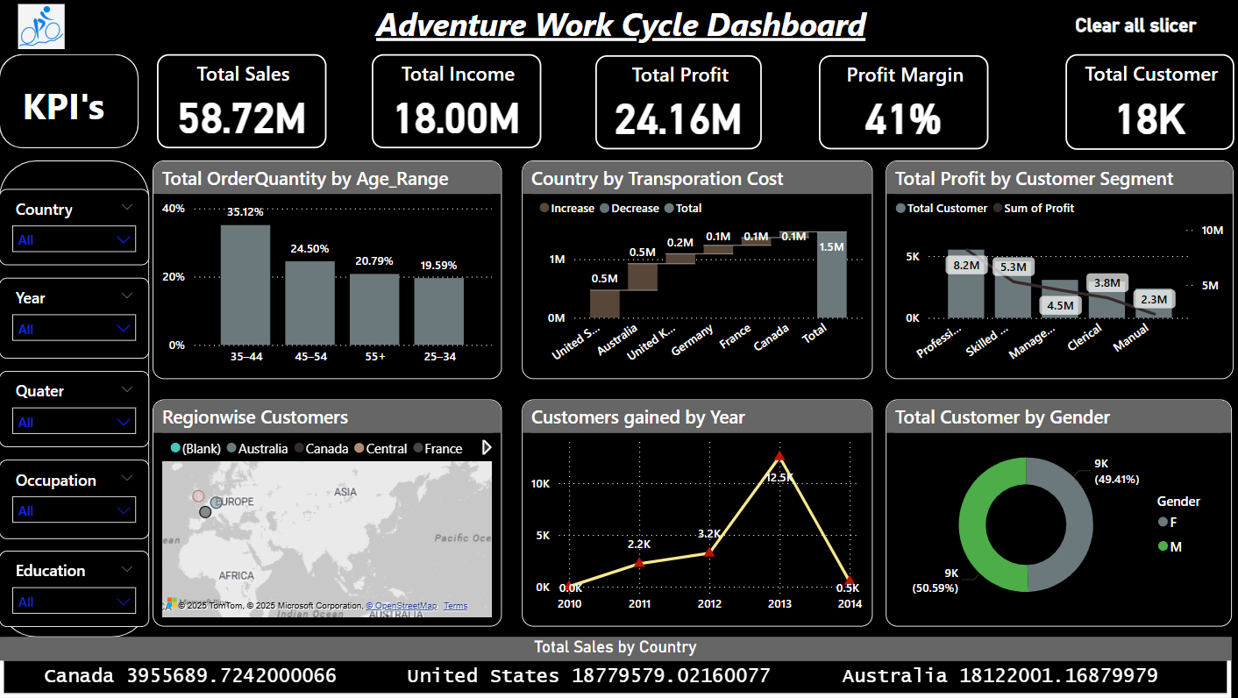
DASHBOARD 1

Slide 19
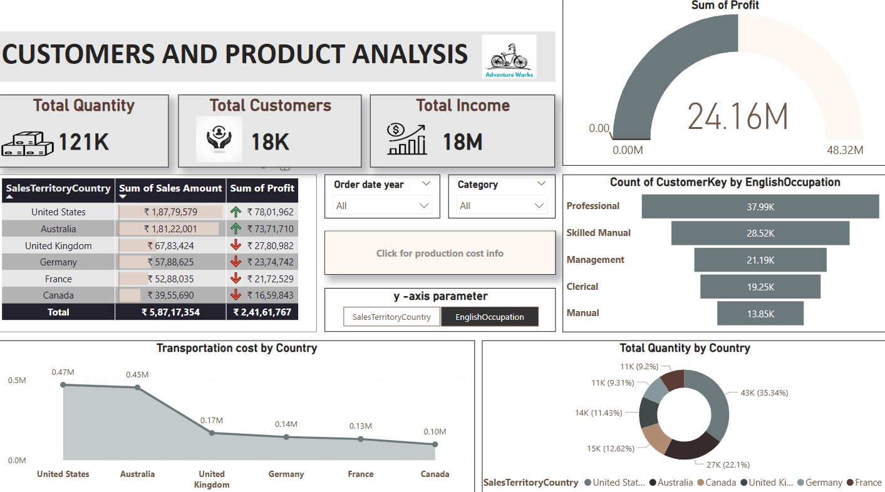
DASHBOARD 2

Slide 20


MYSQL

Slide 21
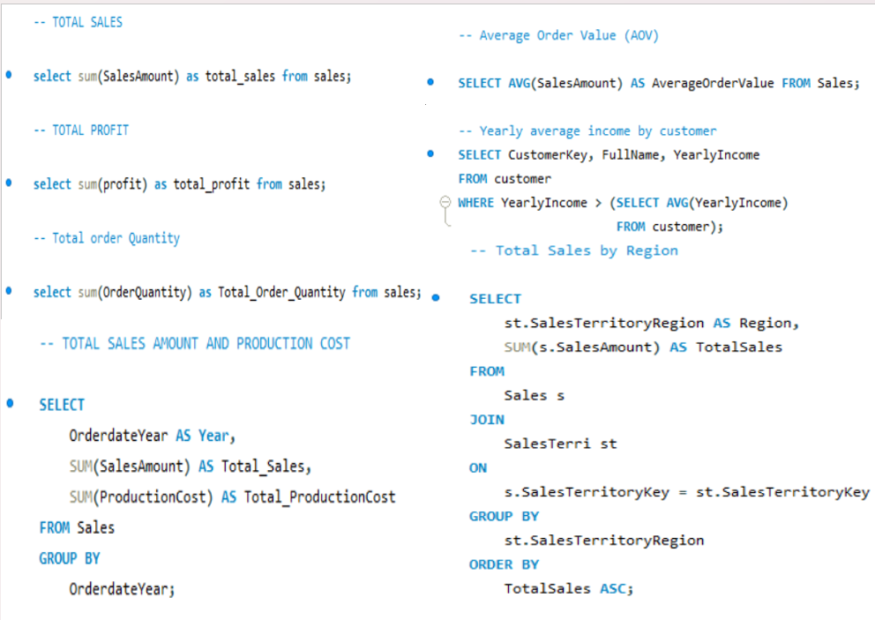

Slide 22
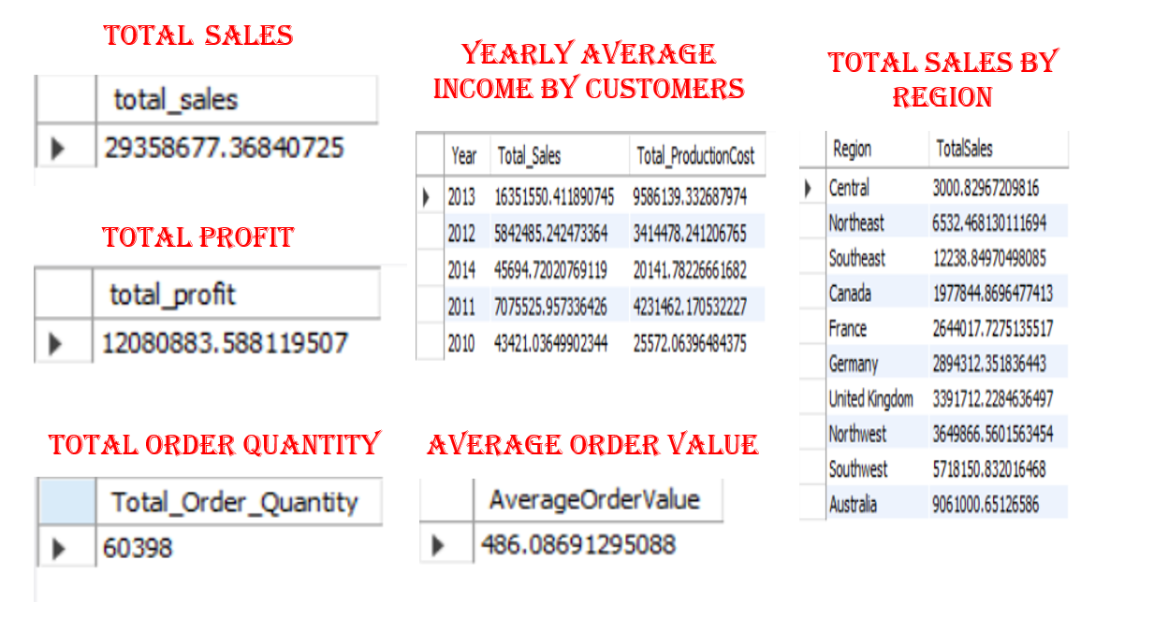

Slide 23

Key Learnings
Identify sales trends and top regions.
Analyze customer demographics.
Optimize inventory management.
Use dashboards for insights.
Leverage Power BI for analysis.
Extract key metrics via SQL.
Identify high-value customers.
Evaluate regional sales trends.
Enhance engagement and profits.
Refine analytics for success.

Slide 24
Summary
The sales analysis project identifies peak sales periods, top-performing regions, and seasonal trends. It examines customer demographics, occupations, and locations to enhance targeted marketing. Inventory management insights help optimize stock levels and production efficiency. The Adventureworks dashboard tracks orders, profit, shipping, and customer segments, while the Sales Performance dashboard focuses on sales distribution, demographics, and market trends. Power BI provides insights into sales, customer growth, profit, and transportation costs. SQL queries extract total sales, profit, and order quantities while analyzing AOV and high-value customers. Regional sales trends are identified using SQL joins, revealing strong and weak markets. These insights drive strategic decisions to improve sales, customer engagement, and operational efficiency. The combination of dashboards and SQL analysis ensures a data-driven approach to business growth. Continuous monitoring and refinement of these insights will help maintain competitive advantage and long-term success.

Slide 25

THANK YOU!

